Slide 1
hypnotherapy as an Intervention for Obesity
Sherri Kozubal, RRT, CRE, RPSGT, CCSH, CHt

Slide 2
Objectives
Define Obesity and the goal in optimal management.
1
Define Hypnotherapy and it’s relevancy Obesity.
2
Describe the role of Hypnotherapy in Weight Loss.
3
Describe the most optimal Hypnotherapy technique to treat and support best weight.
4
Notes:
This presentation touches on my previous presentation with more of a focus on Insomnia from a Hypnotherapy point of view.
That includes Mindset, brain function, cross over of need and tools between Insomnia and Hypnotherapy.

Slide 3
Definition is Everything.
WHO, AMA, CMA, Obesity Canada, Italy all define Overweight and Obesity as abnormal or excessive fat accumulation that may impair health.
Obesity is a complex illness caused by a number of different factors both inside and outside of our control.
Notes:
Obesity Canada The Canadian Adult Obesity Clinical Practice Guidelines (CPGs) provide a much-needed evidence- and experience-based, patient-centered framework for healthcare professionals, patients and policy makers. They represent the first comprehensive update in Canadian obesity guidelines since 2007, and perhaps the most extensive review of published evidence yet conducted in obesity worldwide.
Developed by Obesity Canada and the Canadian Association of Bariatric Physicians and Surgeons, the new CPGs were authored by more than 60 Canadian health professionals, researchers and individuals living with obesity. Together, they assessed well over 550,000 published peer-reviewed articles and built consensus on a wide range of clinical and scientific issues to identify 80 key recommendations.
Obesity is characterized by excess or abnormal body fat that can impair your health. Many organizations including Obesity Canada, the Canadian Medical Association, the American Medical Association, and the World Health Organization consider obesity to be a chronic disease. Italy also recognizes obesity as a chronic disease.

Slide 4
WHO Statistics https://www.who.int/news-room/fact-sheets/detail/obesity-and-overweight
Worldwide obesity has nearly tripled since 1975.
In 2016, more than 1.9 billion adults, 18 years and older, were overweight. Of these over 650 million were obese.
39% of adults aged 18 years and over were overweight in 2016, and 13% were obese.
Most of the world's population live in countries where overweight and obesity kills more people than underweight.
39 million children under the age of 5 were overweight or obese in 2020.
Over 340 million children and adolescents aged 5-19 were overweight or obese in 2016.
Obesity is preventable.
Notes:
Worldwide obesity has nearly tripled since 1975.
In 2016, more than 1.9 billion adults, 18 years and older, were overweight. Of these over 650 million were obese.
39% of adults aged 18 years and over were overweight in 2016, and 13% were obese.
Most of the world's population live in countries where overweight and obesity kills more people than underweight.
39 million children under the age of 5 were overweight or obese in 2020.
Over 340 million children and adolescents aged 5-19 were overweight or obese in 2016.
Obesity is preventable.

Slide 5
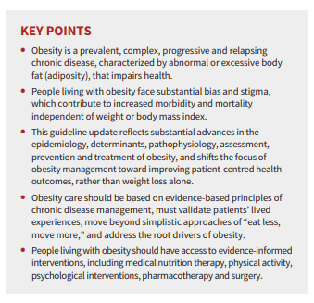
Risk Factors for Obesity

Slide 6
Weight Management
Best Weight = How much weight you can keep off while living an enjoyable life.
Notes:
Weight management is never about how much weight you can lose or how fast you can lose it – all that matters for your overall health and well-being is how much weight you can keep off while still living a life that you can enjoy. This is called your “best weight”.

Slide 7
Training the Brain
High Beta - Increased focus, alertness, or agitation (++ in ADD)
Low Beta – Relaxed focus and attention.
Alpha - Low alpha: 8-10: inner-awareness of self, mind/body integration, balance; High alpha: 10-12: centering, healing, mind/body connection
Alpha-theta border - increase in sensation, abstract thinking and self-control.
Theta Wave Activity - Enhanced: drifting, trance-like state; Suppressed: improve concentration, attentiveness.
Delta Wave Activity – Deep Relaxation Growth Hormone secretion for body repair and regeneration.
Notes:
HIGH BETA (above 18hz): Subjective feeling states: alertness, agitation
Associated tasks & behaviors: mental activity, e.g. math, planning
Physiological correlates: general activation of mind & body functions.
Effects of Training: can induce alertness, but may also produce agitation
LOW BETA (12-15HZ): Distribution: localized by side and by lobe (frontal, occipital, etc)
Subjective feeling states: relaxed yet focused, integrated
Associated tasks & behaviors: low SMR can reflect “ADD”, lack of focused attention
Physiological correlates: is inhibited by motion; restraining body may increase SMR
Effects of Training: increasing SMR can produce relaxed focus, improved attentive abilities,
ALPHA(8-12 Hz): Distribution: regional, usually involves entire lobe; strong occipital w/eyes closed
Subjective feeling states: relaxed, not agitated, but not drowsy; tranquil, conscious
Associated tasks & behaviors: meditation, no action
Physiological correlates: relaxed, healing
Effects of Training: can produce relaxation
Sub band low alpha: 8-10: inner-awareness of self, mind/body integration, balance
Sub band high alpha: 10-12: centering, healing, mind/body connection
GAMMA (above 30hz Hz): Distribution: very localized
Subjective feeling states: thinking; integrated thoughts
Associated tasks & behaviors: high-level information processing, “binding”
Physiological correlates: associated with information-rich task processing
Effects of Training: not known

Slide 8
Obesity Prevalence
Insomnia is a component or result of many other sleep disorders.
Prevalence of Acute and Chronic Insomnias among general population is estimated at 5–15%.
Among HCW’s it is estimated much higher due to the multiple stressors involved with the nature and structure of the work.
Advanced age and female gender are risk factors for chronic or acute models, suggesting hormonal and brain structure components.
Notes:
Insomnia disorder is defined in the International Classification of Sleep Disorders, Third Edition as a complaint of trouble initiating or maintaining sleep which is associated with daytime consequences and is not attributable to environmental circumstances or inadequate opportunity to sleep. It includes both acute (short-term) and chronic forms of Insomnia. Chronic Insomnia is Insomnia that has persisted for at least three months at a frequency of at least three times per week. Insomnia is indeed a component of SWD but can exist independently in Healthcare Workers not working or no longer working in circadian rhythm shifts. In a study by W. McCall et al., looking at Short-term Insomnia Disorder in HCW’s in an academic medical center before and during COVID-19. Insomnia disorder is a common sleep disorder that includes both acute and chronic forms, with respective annual prevalence of at least 8–9% and 6%.^{1,2} Insomnia is associated with the risk of developing other psychiatric disorders,³ poor quality of life,^{4,5} and an increased risk of suicidal ideation and suicidal behavior.^{6,7}

Slide 9
WHO Classification of Weight Status
Obese Class I: BMI 30 – 34.9 kg/m²
Obese Class II: BMI 35 – 39.9 kg/m²
Obese Class III: BMI ≥34.9 kg/m²
Although BMI provides the most useful population-level measure of overweight and obesity, it should be considered a rough guide.
Notes:
WHO CLASSIFICATION OF WEIGHT STATUS (BMI kg/m2 )
Obese Class I .......... 30 - 34.9
Obese Class II ......... 35 - 39.9
Obese Class Ill ........ 40 or greater
However, it should be considered a rough guide because it may not correspond to the same degree of fatness in different individuals.

Slide 10
The Edmonton Obesity Severity Scale (EOSS)
Higher EOSS Stage patients require longer treatment time.
Recommends weight loss only in more severe stages.
Physical or Psychological factors affect weight loss control.
Sensitivity to limitations outside of patient control
5 stage system of obesity classification.
Considers the metabolic, physical, and psychological parameters to guide optimal treatment
Notes:
The Edmonton Obesity Staging System (EOSS) is a five-stage system of obesity classification that considers the metabolic, physical, and psychological parameters in order to determine the optimal obesity treatment [1]. EOSS has been reported to be a better predictor of mortality than BMI or metabolic syndrome.
EOSS suggests that only patients in the more severe stages should be recommended weight loss as the health benefits of weight loss in the lower stages of EOSS are unclear [6, 7].
healthy” patients who possess high insulin sensitivity may be more prone to weight gain and have more difficulty losing weight
Additional factors including psychological disturbances [8] such as depression [9] or anxiety disorders [10] may influence weight loss in obese populations through either medication use or emotional overeating which are commonly associated with these conditions [11, 12]. Similarly, physical limitations or chronic pain that may limit the individual from being able to exercise [13, 14] may also hinder the weight management success in these patients.
Patients in higher EOSS stages required longer treatment times to achieve similar weight outcomes as those in lower EOSS stages.

Slide 11
EOSS Stages
Stage 0:
From a CBT-I point of view. Education, Holistic Approach of Patient Care, and Psych/Behavioral Therapies are implemented.
They suggest several activities that alleviate stress load prior to bed, optimize hormonal pressure to sleep, and minimize extrinsic stressors/stimuli.
Notes:
Stage 1
Patient has obesity-related SUBCLINICAL risk factors
(borderline hypertension, impaired fasting glucose, elevated liver enzymes, etc.)
- OR-
• MILD physical symptoms - patient currently not
requiring medical treatment for comorbidities
(dyspnea on moderate exertion, occasional aches/pains, fatigue, etc.) - OR -
• MILD obesity-related psychological symptoms
and/or mild impairment of well-being
(quality of life not impacted)

Slide 12
Cognitive Behavioral Therapy
Availability and cost can be an issue due to training needed.
Based on the idea that the way you think and feel about something can affect what you do. (perception)
Key concept of CBT is that these thought and behavior patterns can be changed.
Ex. Stress leads to poor, uncharacteristic decisions or calm leads to characteristic, balanced decisions.
Notes:
Sleep Restriction Therapy: A method designed to enhance sleep drive and consolidate sleep by limiting time in bed equal to the patient’s sleep duration, typically estimated from daily diaries.
Time in bed is initially limited to the average sleep duration, and subsequently increased or decreased based on sleep efficiency thresholds, until sufficient sleep duration and overall sleep satisfaction is achieved. SRT is contraindicated for people who suffer from seizures or mood disorders due to the negative effects the temporary sleep deprivation has on these conditions.

Slide 13
Pharmacotherapy
Dependent upon comorbidities, availability, cost, patient preference, and treatment goal.
Often used in combination with CBT-I to boost effectiveness of treatment.
Notes:
The conclusions and recommendations regarding pharmacotherapy must be considered within the context of specific treatment goals, comorbidities, prior treatment responses, availability, safety, patient preference and cost considerations. Despite the clearly favorable benefit to risk ratio of CBT-I, not all patients with an insomnia disorder can and will derive benefit from this treatment alone. This failure may result from inability to access such treatment (due to availability, cost restraints, etc.), inability or unwillingness to participate in the therapy, or treatment non-responsiveness. Thus, pharmacotherapy, alone or in combination with CBT-I

Slide 14
What is Hypnosis?
Hypnosis is a state of consciousness involving focused attention and reduced peripheral awareness characterized by a capacity for response to suggestion.
Everyone has been in a level of Hypnosis through intensely focused activity.
Ability to be actively hypnotized is individual, although most people can be.
Motivation to change is essential.
Notes:
Many factors to consider such as quality, timing, and duration.
Individual variability is somewhat high due to bio psychophysiological factors such as age, gender, culture, ethnicity, social structure, demographic, geography, etc.
Duration is influenced the most by all these factors.
This resulted in the 2015 AASM consensus for sleep amount necessary to support optimal health in adults as 7 – 9 hours. The consensus has not changed since then.

Slide 15
Brain Activity and States of Consciousness
Beta (14-40Hz) = Normal waking consciousness and reasoning wave.
Alpha (7.5-14 Hz) = Gateway to your subconscious mind and intuition. Deep physical and mental relaxation, eyes open or closed, daydreaming, or light meditation.
Alpha-theta border (7-8 Hz) = Optimal range for visualization, mind programming and using the creative power of your mind. You are conscious of your surrounding, however your body is deeply relaxed. Most commonly used in Hypnosis.
Theta (4-7.5Hz) = Hypnosis, deep meditation, light sleep, and REM. The realm of your subconsciousness.
Delta (0.5-4Hz) = Deep, dreamless sleep or very deep transcendental meditation and hypnosis states. Awareness is fully detached and complete subconscious is experienced. Linked to deep healing.
Gamma waves (above 40Hz) = The Insight Wave. Most recently discovered. Initial research shows association with bursts of insight and high–level information processing.
Notes:
Beta: It is associated with a heightened state of alertness, logic and critical reasoning, but can also translate into stress, anxiety, fear and restlessness.
Alpha: It is the optimal time to program the mind for success and it also heightens your imagination, visualisation memory, learning and concentration. It is the gateway to your subconscious mind, and the voice of your intuition, which becomes clearer and more profound the closer you get to 7.5Hz.
Theta It is the realm of your subconsciousness.
Alpha-theta border, This is the mental state in which you consciously create your reality.
Delta It is the slowest of the frequencies. It is the realm of your unconscious mind, and the gateway to the universal mind and collective unconscious, where information is otherwise unavailable at the conscious level. This level (Delta) of deep sleep is important for the healing process as it is linked with deep healing and regeneration.
Gamma waves The fastest frequency at above 40 Hz. Little is known yet about this state of mind. Dr Joe Dispenza works here.

Slide 16
What is Hypnotherapy?
Definition: The use of hypnosis for treatment of a medical or psychological disorder or concern.
Typically, the last line of therapy used due to availability, regulation, and acceptance.
Effectively used with perception issues such as sleep, addictions, trauma, pain, and anxiety.
Shifts consciousness intentionally to reframe perception towards that which benefits positive outcome.
Notes:
Many factors to consider such as quality, timing, and duration.
Individual variability is somewhat high due to bio psychophysiological factors such as age, gender, culture, ethnicity, social structure, demographic, geography, etc.
Duration is influenced the most by all these factors.
This resulted in the 2015 AASM consensus for sleep amount necessary to support optimal health in adults as 7 – 9 hours. The consensus has not changed since then.

Slide 17
What does a Hypnotherapy session look like?
Rapport
Set intention and expectation.
Center
Refocus inward and body perception
Induction
Shift away from body awareness.
Reframe
Hypnotic suggestion to update subconscious program/limiting belief
Deepener
Use of Somatic and Visualization techniques to achieve required state.
Discussion
Anchor subconscious learning in conscious state.
Notes:
Many factors to consider such as quality, timing, and duration.
Individual variability is somewhat high due to bio psychophysiological factors such as age, gender, culture, ethnicity, social structure, demographic, geography, etc.
Duration is influenced the most by all these factors.
This resulted in the 2015 AASM consensus for sleep amount necessary to support optimal health in adults as 7 – 9 hours. The consensus has not changed since then.

Slide 18
Cognitive Rehearsal Technique
The brain does not know the difference between rehearsal and actually carrying out the behavior.
client imagines those situations that tend to produce anxiety or self-defeating behavior and then repeats positive coping statements or mentally rehearses more appropriate behavior.
Adapted from CBT Interventions List.
In hypnosis, we role play what “should have” happened.
Result is a feeling of preparedness for future exposures and belief of a desired outcome.
Notes:
Defined by the American Psychological Association as a therapeutic technique in which a client imagines those situations that tend to produce anxiety or self-defeating behavior and then repeats positive coping statements or mentally rehearses more appropriate behavior.
Cognitive rehearsal is a cognitive behavioral therapy technique from the CBT interventions list that helps reduce anxiety in the patient by acting out a scenario. The mental health professional asks the patient to recall a time in their past where a dysfunctional moment occurred.
They work together to amend the patient's thought process to reflect a more positive way of thinking. This changes the patient's thought process and better equips them for the next time a similar situation arises. It can help with stressful situations and help the patient control their environment.
By identifying cognitive distortions through imagination, the mental health professional can halt any behavioral issues before they arise again.

Slide 19
Changing Eating Behavior
People decide to act before they acknowledge it. (Free will)
Decisions are based on prior experience.
Cognitive Rehearsal most effective.
Psychological interventions have small to medium effect on weight loss.
Notes:
Free will is the notional capacity or ability to choose between different possible courses of action unimpeded

Slide 20
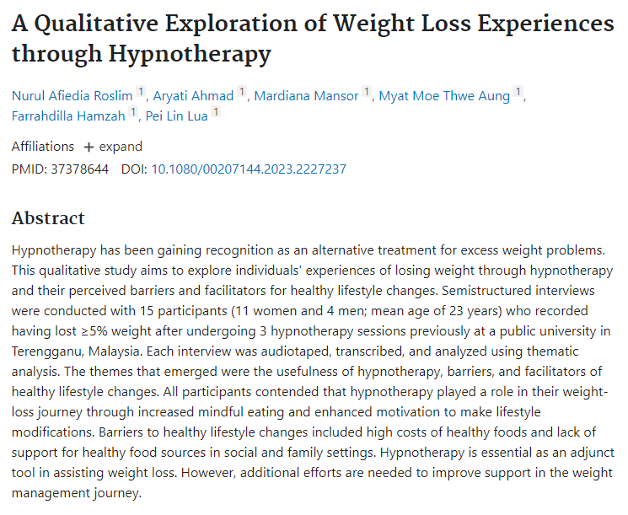
Barriers and Facilitators of Healthy Lifestyle Change
“Semi structured interviews … 15 participants (11 women and 4 men; mean age of 23 years) … recorded having lost ≥5% weight after undergoing 3 hypnotherapy sessions previously at a public university in Terengganu, Malaysia.”
“All participants contended that hypnotherapy played a role in their weight-loss journey through increased mindful eating and enhanced motivation to make lifestyle modifications.”
“Barriers to healthy lifestyle changes included high costs of healthy foods and lack of support for healthy food sources in social and family settings.”
“Hypnotherapy is essential as an adjunct tool in assisting weight loss. However, additional efforts are needed to improve support in the weight management journey.”
Notes:
Hypnotherapy has been gaining recognition as an alternative treatment for excess weight problems. This qualitative study aims to explore individuals’ experiences of losing weight through hypnotherapy and their perceived barriers and facilitators for healthy lifestyle changes. Semi structured interviews were conducted with 15 participants (11 women and 4 men; mean age of 23 years) who recorded having lost ≥5% weight after undergoing 3 hypnotherapy sessions previously at a public university in Terengganu, Malaysia. Each interview was audiotaped, transcribed, and analyzed using thematic analysis. The themes that emerged were the usefulness of hypnotherapy, barriers, and facilitators of healthy lifestyle changes. All participants contended that hypnotherapy played a role in their weight-loss journey through increased mindful eating and enhanced motivation to make lifestyle modifications. Barriers to healthy lifestyle changes included high costs of healthy foods and lack of support for healthy food sources in social and family settings. Hypnotherapy is essential as an adjunct tool in assisting weight loss. However, additional efforts are needed to improve support in the weight management journey.

Slide 21
Barriers and Facilitators of Healthy Lifestyle Change
“Semi structured interviews … 15 participants (11 women and 4 men; mean age of 23 years) … recorded having lost ≥5% weight after undergoing 3 hypnotherapy sessions previously at a public university in Terengganu, Malaysia.”
“All participants contended that hypnotherapy played a role in their weight-loss journey through increased mindful eating and enhanced motivation to make lifestyle modifications.”
“Barriers to healthy lifestyle changes included high costs of healthy foods and lack of support for healthy food sources in social and family settings.”
“Hypnotherapy is essential as an adjunct tool in assisting weight loss. However, additional efforts are needed to improve support in the weight management journey.”
Notes:
Hypnotherapy has been gaining recognition as an alternative treatment for excess weight problems. This qualitative study aims to explore individuals’ experiences of losing weight through hypnotherapy and their perceived barriers and facilitators for healthy lifestyle changes. Semi structured interviews were conducted with 15 participants (11 women and 4 men; mean age of 23 years) who recorded having lost ≥5% weight after undergoing 3 hypnotherapy sessions previously at a public university in Terengganu, Malaysia. Each interview was audiotaped, transcribed, and analyzed using thematic analysis. The themes that emerged were the usefulness of hypnotherapy, barriers, and facilitators of healthy lifestyle changes. All participants contended that hypnotherapy played a role in their weight-loss journey through increased mindful eating and enhanced motivation to make lifestyle modifications. Barriers to healthy lifestyle changes included high costs of healthy foods and lack of support for healthy food sources in social and family settings. Hypnotherapy is essential as an adjunct tool in assisting weight loss. However, additional efforts are needed to improve support in the weight management journey.

Slide 22
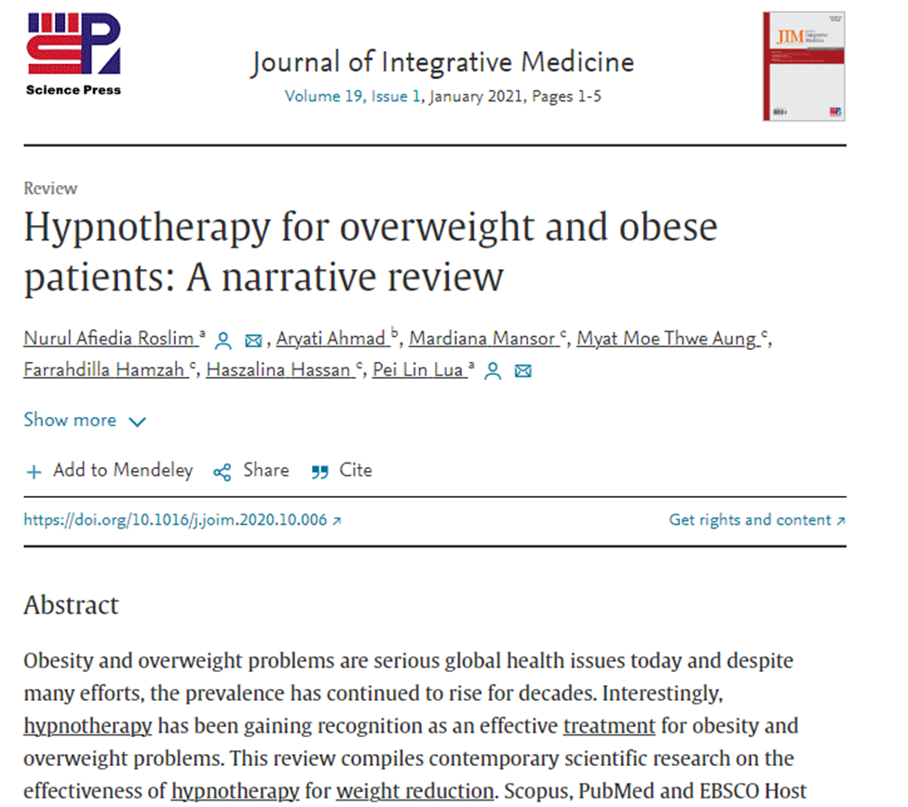
Gaining Recognition
“A total of 539 respondents (82.7% women and 17.3% men) between the ages of 17 and 67 years were represented in the seven studies.”
“Although the literature has generally identified hypnotherapy as a useful adjuvant for weight loss, its effectiveness remains unclear and has not been scientifically replicated. It is also one of the least-researched therapies, and the evidence is limited due to duration of the intervention and its long-term effectiveness.”
“We conclude that hypnotherapy has been shown to be a safe and effective adjuvant treatment for assisting weight loss. However, methodological weaknesses such as small sample sizes, high drop-out rates, therapist allegiance effects, varied techniques and duration of the hypnotherapy interventions have prevented a more concrete conclusion.”
Notes:
Obesity and overweight problems are serious global health issues today and despite many efforts, the prevalence has continued to rise for decades.
Interestingly, hypnotherapy has been gaining recognition as an effective treatment for obesity and overweight problems.
Most studies incorporated lifestyle changes, such as changes of dietary habit and behavioral recommendations in the hypnotic procedure.
Their results suggested that the use of hypnotherapy not only promoted weight reduction during the treatment period but also after treatment cessation, and in some cases, one to ten kilograms were lost during follow-up periods. In addition, one study even showed increased physical activity among the hypnotised individuals. This use of hypnotherapy also improved respondents’ eating behavior and quality of life. However, a definitive conclusion could not be drawn due to several methodological flaws and the limited number of published studies in this area. Therefore, further well-designed studies are needed to substantiate the effectiveness of hypnotherapy for this modern-day health problem.
we suggest that further well-designed trials of a similar nature, but including gender balanced populations, are needed to conclusively demonstrate the

Slide 23
Summary
Hypnotherapy is becoming more widely accepted due to it’s low risk factors and many positive outcomes in sleep disorders as well as cognitive and physical diseases.
Notes:
The sleep health of the HCW has taken on some much needed attention in the aftermath of the Covid-19 Pandemic. One of the few silver linings, if you will. Attention needs to be drawn to the culture around sleep, sleep shifts and support for sleep disturbances prior to development into a disorder. Taking a proactive approach with the mind body connection, the interplay of diet, exercise, and rest in overall impact on QoL and sleep. Finally, awareness and sensitivity needs to be elevated to the importance of sleep on quality of work, overall health and safety so that the HCW can confidently complete their patient care to optimal levels and seek help with confidence when care is required for them.
Care centers need to consider their abilities to allow for adequate sleep time between shifts, offer decompression techniques in relation to work stress and trauma, offer sleep education, and hire adequate staff to allow scheduling of shift work within care centers that lessens the impact on it’s workers.

Slide 24
References
Roslim, N. A., Ahmad, A., Mansor, M., Aung, M. M. T., Hamzah, F., & Lua, P. L. (2023). A Qualitative Exploration of Weight Loss Experiences through Hypnotherapy. The International journal of clinical and experimental hypnosis, 71(3), 235–249. https://doi.org/10.1080/00207144.2023.2227237
Comșa, L. T., David, O. A., & David, D. O. (2022). Eating Behavior-Choice or Reconstruction of Past Experience? A Randomized Clinical Trial of Changing Eating Intentions of Healthy Adults Through Hypnotic Suggestions. Behavior therapy, 53(2), 323–333. https://doi.org/10.1016/j.beth.2021.09.005
Erşan, S., & Erşan, E. E. (2020). Effects of Hypnotherapy on Weight Loss and thus on Serum Leptin, Adiponectin, and Irisin Levels in Obese Patients. Journal of alternative and complementary medicine (New York, N.Y.), 26(11), 1047–1054. https://doi.org/10.1089/acm.2020.0104
Delestre, F., Lehéricey, G., Estellat, C., Diallo, M. H., Hansel, B., Giral, P. (2022). Hypnosis reduces food impulsivity in patients with obesity and high levels of disinhibition: HYPNODIET randomized controlled clinical trial. The American Journal of Clinical Nutrition, 115(6), 1637–1645. https://doi.org/10.1093/ajcn/nqac046
Wharton, S. (2020). Obesity in Adults: A Clinical Practice guideline. CMAJ 2020 August 4;192:E875-91. https://doi: 10.1503/cmaj.191707
Roslim, N. A., Ahmad, A., Mansor, M., Aung, M. M. T., Hamzah, F., Hassan, H., Lua, P. L. (2021). Hypnotherapy for overweight and obese patients: A narrative review, Journal of Integrative Medicine, 19 (1), 1-5, ISSN 2095-4964. https://doi.org/10.1016/j.joim.2020.10.006.

